Slide 1
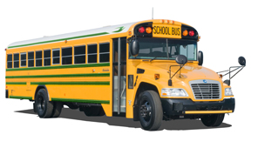
Brandon School Division
Alternative Fuels – The Canadian Experience

Slide 2
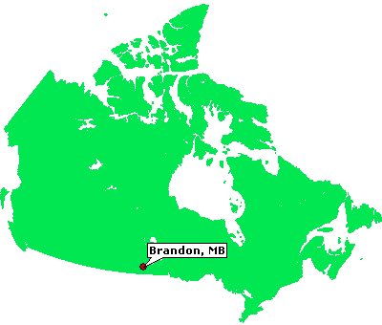
Brandon School Division
Mixture of 34 Urban and Rural Routes
Growing School District (rapidly approaching 10,000 students)
Extreme Weather Conditions from -45 C windchills in winter to over +35 C in June and September

Slide 3
Why Look at Alternative Fuels
Notes:
This graph represents the increase in FCL Propane’s fleet repairs and maintenance over the last 10 years
Likely is also representative of your school divisions’s bus maintenance expenses
~ 100 diesel powered units, number grows each year as units are added which will have a slight affect on the annual increases
2010 is when emission regulations tightened on diesel engines
Coincidentally since that time R&M has risen uncontrollably and since 2005 has essentially doubled
WHY?

Slide 4
Background
Brandon School Division was seeking an alternative to Diesel Technology due to increasing costs and downtime.
Brandon School Division had been contacted in the summer of 2013 by the Pupil Transportation Unit to participate in field trials of a propane powered school bus.
Due to insurance issues the intended trial of running the bus on actual pickup routes did not occur.
Brandon School Division contacted the PTU early December 2013 with a different idea.

Slide 5
Background
Brandon School Division offered to run simulated routes with the bus without students on board.
The Pupil Transportation Unit and Fairway Specialty Vehicles responded very quickly to take advantage of the upcoming extreme conditions to put the trial in place.
At no time was the bus plugged in during the trials nor did the bus have a winter front.

Slide 6
Focus on Propane
Why did we focus on Propane
Abundant fueling infrastructure
Inexpensive fueling equipment
Potential for savings
Reliability
Opportunity – there was a will to reintroduce the technology to the province
Reported to have excellent cold weather performance
Low Maintenance costs
Other technologies (Electric, CNG, Hybrid) were not feasible at the time.

Slide 7
Observations December 9 2013
Simulation of in-city route:
Ambient Temp Start -29C End -26C
Windchill Temp Start -41C End -37C
Simulation run time 9:45 – 11:35
Cabin temp climbed to 21C within 20 minutes
The driver actually turned down the heat.
Cabin heat was uniform throughout the bus
Driver commented that bus has power on uphill grade, uniform heat and handles well

Slide 8
Observations December 11 2013
Simulation of in-city lift bus route:
Ambient Temp Start -31C End -24C
Windchill Temp Start -44C End -34C
Simulation run time 10:00AM – 1:00 PM
Cabin temp climbed to maximum of 26C
This route picks up and drops off 6 students with wheelchairs as well as other students
Cabin heat recovered quickly after simulating loading wheelchair students

Slide 9
Observations December 14 2013
Simulation of Field Trip
Ambient Temp Start -23C End -23C
Windchill Temp Start -26C End -31C
Simulation run time 10:00 to 12:05
Cabin temp of 25.6C for duration of trip
165 km, 87 L propane, 52.7 L/100KM

Slide 10
Fuel economy observed for the complete trial
Propane (Bluebird):
827 km, 466.4L
56.4L/100km, 4.17 US mpg
Diesel Fleet (approx same time frame):
45534 km, 18772L
42.8L/100km 5.49USmpg

Slide 11
2015 Update
Maintenance costs have been very low. They have seen very little time in the shop.
The fuel vendor was very supportive in setting up our fuel facility. Our only costs were running hydro to the facility and permit costs. Our chosen vendor also trained and certified several of our staff to use the fueling facility at no cost.
We have since certified our own trainer and train our own staff.

Slide 12
Cold Weather Starting
January 5 2015 Brandon School Division cancelled rural routes due to wind chill values in excess of -45 as well as 14 buses not starting that morning. All 14 buses that did not start were Diesel buses.
The Propane buses have started every day.

Slide 13
Cold Weather Start -34 C actual -44 C windchill

Slide 14
Propane Advantages
Fuel Savings
Maintenance Savings
Cold Weather Plug-in Savings
Cold Weather Reliability
Cold Weather Comfort
Quieter ride for both Driver and Students
Smaller Carbon Footprint
Safe

Slide 15
Operating Costs
 | Diesel Fleet All Units | Cummins/Def Fleet | Propane Fleet
2015 2016
Maint $/km | 0.3312 | 0.1781 | 0.0337
Fuel $/km | 0.3320 | 0.2748 | 0.2374
Total $/km | 0.6633 | 0.453 | 0.2711
2016 2017
Maint $/km | 0.2396 | 0.1881 | 0.0807
Fuel $/km | 0.3542 | 0.3042 | 0.2957
Total $/km | 0.5938 | 0.4923 | 0.3764
2015 2016 |  | Savings over All Diesel | Savings vs Cummins/DEF
Propane Kms | 101029 | 39623.57 | 18377.18
2016 2017 |  | Savings over All Diesel | Savings over Cummins
Propane Kms | 251949 | 54773.71 | 29200.89
Propane Bus KMs |  | VS All Diesel | VS Cummins/DEF
Total savings 2015-2017 |  | 94397.29 | 47578.06

Slide 16
Challenges
The main challenge has been fuelling capability.
Fill times on a 340 L tank – about 10 minutes (12 buses =120 minutes)
Only 1 bus can access our on site fueling station at a time.
Our fuel vendor put together an innovative solution to our fueling needs as our fleet was growing. They implemented a change in their POS software to allow fueling at their retail locations at our pricing. This essentially tripled our fueling capability.
Implementation of newer fueling technology would significantly improve fueling times and operator safety.
The other challenge has been pricing of the propane bus itself and justification of purchasing a higher priced product.

Slide 17
2018 and Beyond
Brandon School Division currently has 12 propane buses in it’s fleet of 43 buses.
We will have 16 propane buses in our fleet of 45 buses for the fall of 2018.
If we continue on our current purchasing program we will be an all propane fleet by 2025.
By the end of the 2019 2020 school year we will have put over 1,000,000 lbs fewer CO2 emissions into the environment than if we had continued with the diesel product.

