Slide 1
Summary of Evidence on Business Risk
Case No. R-4156-2021
June 17, 2022
Asa S. Hopkins, PhD

Slide 2
Agenda
My approach in this proceeding
Principles
Distribution utilities
  Short term (volatility) risk
  Long term (capital recovery) risk
  Conclusions
Intragaz
Dr. Asa Hopkins

Slide 3
Introduction

Slide 4
My Approach to this Proceeding
Gas utility business, finances, and operations, and their associated risks, are shaped by the regulatory and policy regime in which the utilities operate
  Utility regulation is a manifestation of policy
My testimony informs the Régie about the business risk of the three gas utilities, viewed through a regulatory and policy lens, particularly (but not limited to) as it relates to greenhouse gas emission mitigation (the “energy transition”)
  I have evaluated the Aviseo study as well as Dr. Brown’s and Dr. Villadsen’s expert testimony, and conducted my own analysis
  Dr. Brown’s testimony compares the business risk of the three Québec utilities to the US gas utility sample, and Dr. Villadsen incorporates that relative risk assessment into her recommendations on ROE and capital structure
    I agree with Dr. Brown that many of the operating risks identified in the Aviseo report are not different between the US sample and the Québec utilities, and can therefore be set aside when considering the ROE and capital structure
    Focus of my evidence is on areas of potential difference from the US gas sample: regulatory and policy context, and competition
Dr. Asa Hopkins

Slide 5
Role of Business Risk in Cost of Capital Case
Allowed return on equity and capital structure should reflect the return that investors would demand for investing in a prudently run utility facing the same financial and business situation as the utility; this is a fair “cost of capital”
Financial situation reflects the overall market demand for return from equity investments, accounting for the level of risk for “benchmark” regulated utilities
Business risks reflect specific risks or types of risk that a given utility faces due to its business context (e.g., regulatory context, customer context, competitive context)
  Prudent utility managers evaluate risks and analyze the costs that those risks might impose along with the costs of efforts to mitigate them
  They then take the actions that are warranted to mitigate risks, with appropriate corresponding approvals by their regulators
Dr. Asa Hopkins

Slide 6
Categories of Business Risk
Short term business risk
  Risk that the utility may receive less revenue than expected and/or may be forced to pay unexpected costs
  Manifested in the variability in the rate of return earned by utility shareholders
  Operational in nature, strongly impacted by regulatory lag
Long term business risk
  Risk that utility may be unable to both recover its invested capital and earn a reasonable return on that capital
  Associated with risk that assets may become “stranded” (a stranded cost is the undepreciated value of an asset that is no longer used and useful)
  Two ways the unexpected could come to pass:
    Regulator may not allow recovery of capital for assets no longer used and useful
    Competition may limit ability of utility to charge rates sufficient to recover its full cost of service
Dr. Asa Hopkins

Slide 7
Timescales of Risk and ROE
ROE and capital structure should primarily reflect the risk facing the utility during the period the ROE is in effect
Short term risks should be the primary driver
  If there were capital recovery risks in the short term, these should also be included, but there are no such risks in this case
If there were well justified capital risks in other, later, periods, then those could be taken into account even during the immediate period
  However, no such risks have been sufficiently justified in this proceeding
Dr. Asa Hopkins

Slide 8
Short Term (Volatility) Risk

Slide 9
Short Term Risk for Québec Distribution Utilities
Volatility in returns is associated with risk, and “Other things equal, investors prefer returns that are less volatile” (Exhibit ÉGI-2, page 8, line 11)
  That is, lower-volatility investments have a lower cost of capital, all else equal
Regulatory tools like deferral accounts, decoupling, multi-year rate plans, or frequent rate cases shorten or eliminate regulatory lag and thereby lower business risk
  Low volatility of returns in an indicator of short regulatory lag
Québec’s regulatory policy has established these kinds of tools for Énergir and Gazifère
The utilities’ demonstrated low variability in returns (while consistently exceeding their allowed rates of return) shows that these tools successfully lower regulatory lag, and thus business risk, for the utilities
Dr. Asa Hopkins

Slide 10
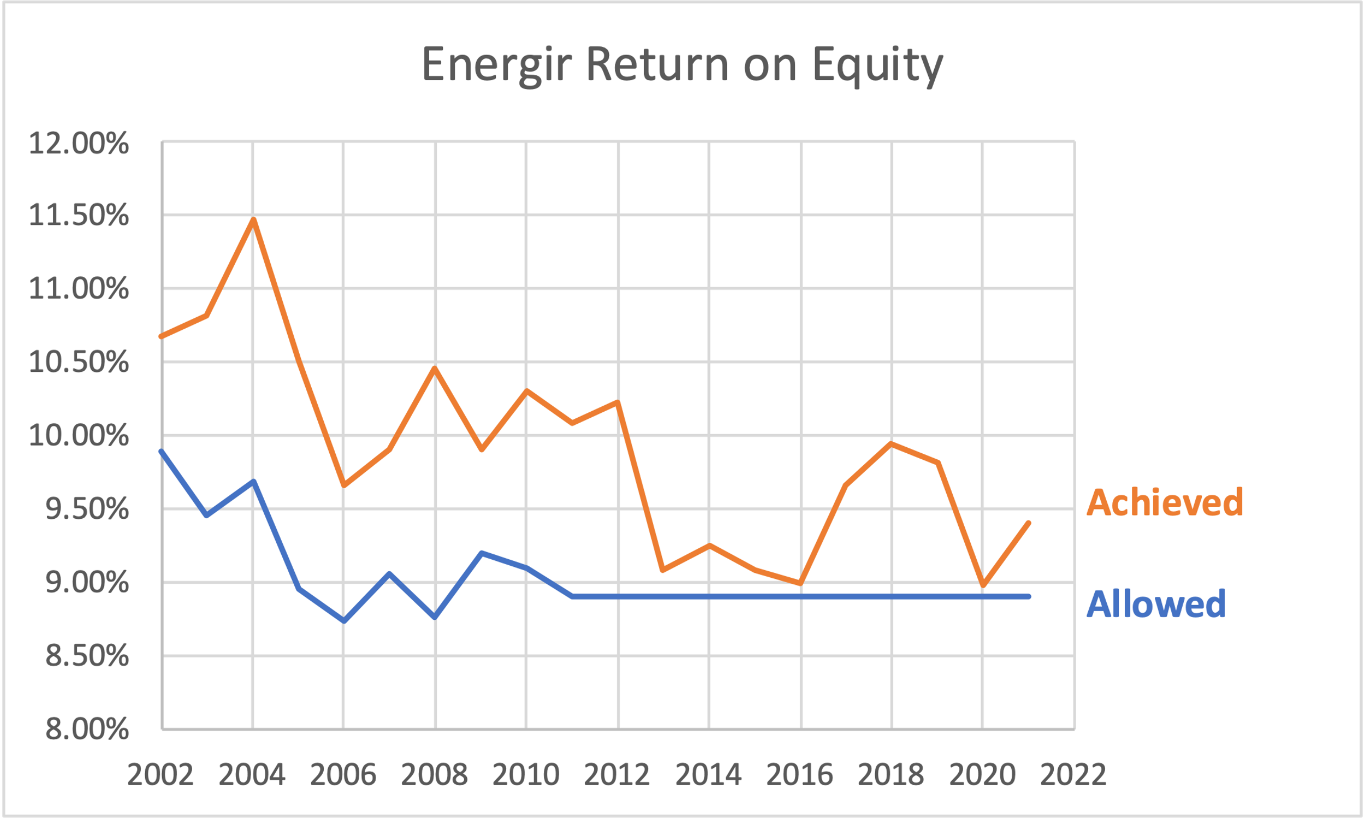
Return on Equity for Énergir
Standard deviation of achieved ROE: 0.5%
Dr. Asa Hopkins

Slide 11
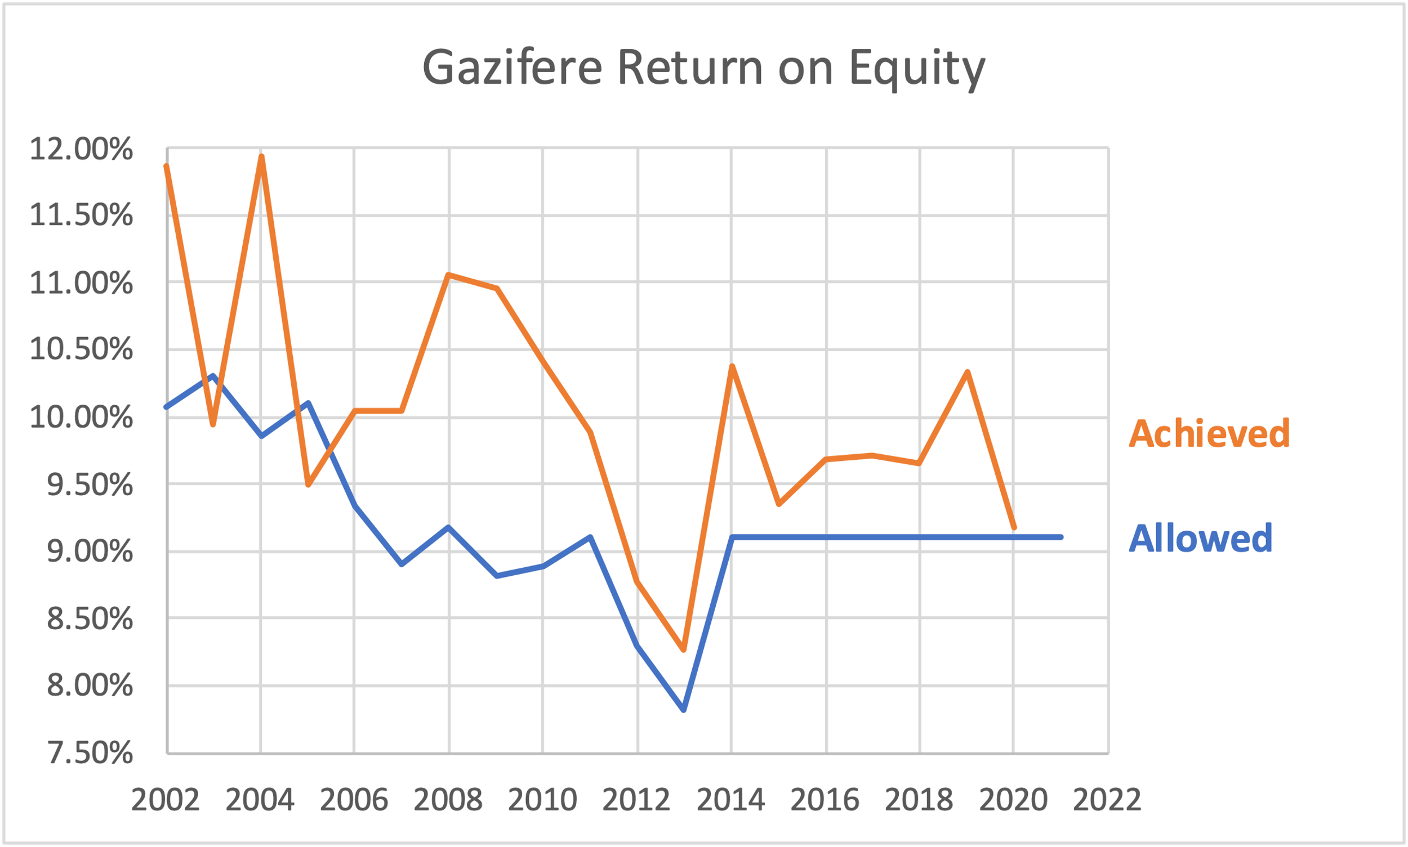
Return on Equity for Gazifère
Standard deviation of achieved ROE: 0.68%
Dr. Asa Hopkins

Slide 12
Comparison with US Gas Sample
Dr. Villadsen proposes use of a U.S. gas utility sample to derive a range of costs of capital experienced in the equity market
To use this sample for its intended purpose, need to know and account for the relative risk of the sample companies and the Québec utilities
To support the case that the sampled utilities are comparable, Dr. Brown states that “the utilities in the sample … have similar regulatory lag to Énergir” (Exhibit ÉGI-2, page 27, line 25)
However, if they had similar regulatory lag, they would have similar volatility in their achieved returns, which they do not
  The US gas utilities also, on average, underperform their allowed ROE
The US gas utility sample also includes utilities that are not “essentially … pure-play local distribution” utilities (despite Dr. Villadsen’s claims), and utilities that have engaged in activities and lines of business that are different from the Québec utilities
Dr. Asa Hopkins

Slide 13
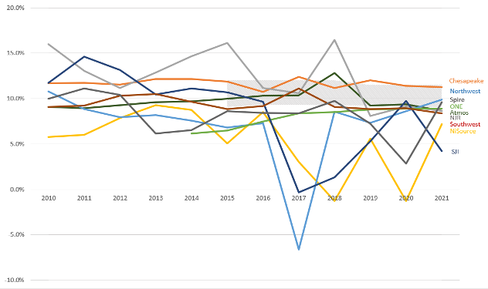
Achieved ROE for US Gas Utility Sample
Dr. Asa Hopkins

Slide 14
Volatility in Achieved Returns
 | Standard Deviation
Atmos | 1.09%
Chesapeake | 0.48%
NJR | 3.00%
NiSource | 3.57%
NW Natural | 4.46%
ONE | 1.11%
SJI | 4.73%
Southwest Gas | 0.81%
Spire | 2.29%
Énergir | 0.50%
Gazifère | 0.68%
Dr. Asa Hopkins

Slide 15
Conclusions from Analysis of Achieved ROE
Énergir and Gazifère demonstrate lower regulatory lag and lower volatility of returns than the US gas utility sample, which indicates a lower level of short term business risk
All else equal, this implies that Énergir and Gazifère should have lower cost of capital than the US gas utility sample
Dr. Asa Hopkins

Slide 16
Suitability of US gas sample
Greater volatility of the US gas sample could be related to the fact that the sample includes companies with substantial business outside of regulated gas distribution, and thus different risks from Énergir or Gazifère
  Chesapeake: 51% of assets are in regulated gas distribution; bulk of the rest in gas transmission
    Note this is a correction from my filed evidence
  South Jersey Industries: less than half of revenues from utility operations
  New Jersey Resources: 62% of assets in gas distribution; also develops solar generators and engaged in wholesale and retail gas supply, transportation, and storage
  NW Natural: took a substantial loss in 2017 from investment in an unregulated gas storage business
In addition, NiSource experienced a gas-related disaster and sold its Massachusetts gas distribution business during the analysis period

Slide 17
Long Term (Capital Recovery) Risk

Slide 18
Long Term Risk
Recall the forms of long-term risk:
  Regulator may not allow recovery of capital for assets no longer used and useful
  Competition may limit ability of utility to charge rates sufficient to recover its full cost of service
Potential drivers for long term risk in Québec:
  Policies and actions to reduce greenhouse gas emissions
  Competitive position of gas vs. electricity
Dr. Asa Hopkins

Slide 19
GHG Emission Reduction Policies
Both US and Canadian utilities face national-level drivers to reduce emissions as part of a path to net zero emissions by 2050
  Long term energy transition impacts are roughly comparable in the two countries
Impacts on gas utilities in both countries will be modest over the next decade:
  New technologies take time to penetrate markets
  Stock turnover times for heating equipment are generally long (>15 years)
  Énergir and US sources both point to an 18-22 percent reduction in gas throughput to buildings by 2030 as part of a policy-consistent path
Reduction in gas throughput (and emissions) is not directly causally linked to capital recovery risk
  Utilities can take actions to mitigate the impact of sales changes on capital recovery, with the approval of regulators
Dr. Asa Hopkins

Slide 20
Competition Risk
The capital recovery risk from competition is not that competition might lead to a reduction in sales
To impact capital recovery, the competition would have to be stiff enough that the utility is unable to recover its revenue requirement
  That is, a case in which increasing rates would drive sales down further, and there is no rate at which the whole revenue requirement could be recovered
  Regulators and utilities would almost surely work together to avoid getting to this point
Comparison with the US sample
  Quantitative analysis of relative competitiveness of gas and electric in the US jurisdictions is necessary to evaluate this relative risk
  Climate matters
  Savings between gas and electric bills could be different (in US and Québec) yet not have a material effect on relative competition risk
Dr. Asa Hopkins

Slide 21
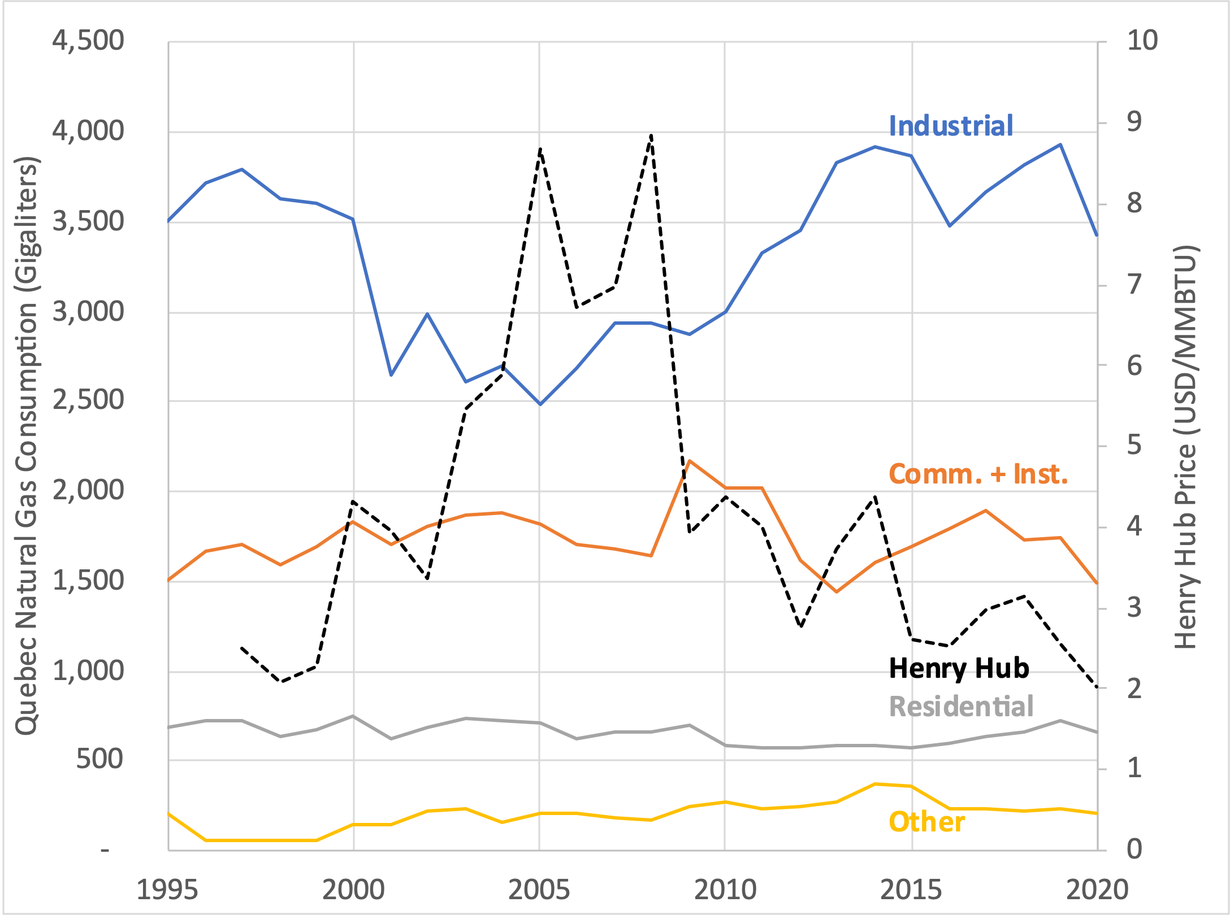
Competition Risk
Looking at the last 25 years, Québec customers continued to use gas even when gas prices were substantially higher
  Particularly residential, commercial, and institutional customers that provide the most revenue for distribution, and where the sales impact from electrification is higher
Gazifère analysis shows past and present customer bill advantage of gas over electricity
  Énergir Climate Resilience Plan analysis shows continued competitive advantage in the future
There is likely to be considerable room for gas rates to rise without crossing a tipping point where the utility would be unable to recover its revenue requirement
Dr. Asa Hopkins

Slide 22
Planning is Essential
Faced with changes in sales, utility managers can mitigate risks by developing a business plan for managing the firm in the changing public policy and competitive context in which it operates
Identify and quantify risks and opportunities, including when they would impact on the company and what their impacts would be
Include a comprehensive assessment of electricity and gas utility roles in decarbonization, gas load forecasts, infrastructure needs, gas price forecasts, analysis of customer counts and consumption patterns by customer type, and the availability and costs of alternative fuels
A plan would reduce uncertainty regarding each company’s future business, and thereby lower investor risk
A plan should also inform analysis of, and selection of, additional mitigating actions
Aviseo risk assessment report is not a plan; Énergir’s Climate Resiliency Report does not contain detailed analysis and evaluation of options (although the 2021 version has the seeds of this analysis)
Dr. Asa Hopkins

Slide 23
Other Potential Mitigating Actions
Examine any choice to invest in new gas system infrastructure
  Including the useful life of that infrastructure (which informs the appropriate depreciation rate) and the options for non-pipeline alternatives
Reevaluate depreciation approaches for each type of utility asset, including differentiating among assets that serve different types of customers that may have different long-term usage patterns for those assets
Develop partnerships with electric utilities to meet winter peak needs through the gas system, subject to regulatory approval (as the Régie has approved the Énergir-HQD proposal)
Evaluate low-carbon fuels such as green hydrogen or biomethane, including costs and availability as well as impact on pipeline performance and leakage
Dr. Asa Hopkins

Slide 24
Lessons from Other Utilities
Green Mountain Power, an affiliate of Énergir, has conducted planning that the Utilities can learn from
  GMP Climate Plan and Integrated Resource Plan take an integrated view across the utility’s operations and financial and regulatory approaches in the context of long-term planning
Lessons include:
  The importance of long-term business planning
  The value of taking an integrated view across the whole of a utility’s business, including the drivers and needs of its diverse customers
  The need for a utility’s plan and actions to be developed within its particular policy and economic context, in particular reflecting the need to address climate change mitigation, adaptation, and associated risks
  The importance of incorporating the utility’s financial and regulatory positions and approach in its planning process, including laying out in detail how those financial aspects of the utility need to adapt as the plan is implemented
Dr. Asa Hopkins

Slide 25
Actions in Québec
Énergir and Hydro-Québec Distribution are pursuing a dual-fuel approach to building decarbonization
  Added electric heating systems would displace gas use during most of the winter
  On the coldest days, customers would use the gas system instead, reducing capacity needs for HQD
Begins a new business model for Énergir with a new “customer” in the form of HQD that is paying it for a new kind of service, and the revenues can help mitigate rate concerns from decarbonization for Énergir customers, and capital recovery risk for Énergir shareholders
The potential proposal from Énergir (discussed during this hearing) to change the “profitability” required to support new customer interconnection reflects my first recommendation
  (Examine any choice to invest in new gas system infrastructure, including the useful life of that infrastructure)
Dr. Asa Hopkins

Slide 26
Comparison with the US Gas Sample
U.S. gas sample utilities are only beginning to conduct the kind of analysis and actions that I recommend for utilities facing energy transition
  Oregon climate law is spurring NW Natural and its regulator to conduct more comprehensive planning
To my knowledge, none of the US sample utilities have proposed risk-mitigating actions of the scale and potential of the Énergir-HQD bi-energy structure
Dr. Asa Hopkins

Slide 27
Industrial Customers and Long-Term Risk
Rather than being a source of risk in the context of decarbonization, industrial customers are likely a source of business opportunity for gas utilities
Industrial customers are less likely to electrify than other rate classes, and more likely to provide demand for biomethane and hydrogen (to be delivered by pipe)
Industrial customers now using liquid petroleum may find it advantageous to connect to pipelines to access low-carbon gases
Also a potential market opportunity for CO₂ pipelines to safely carry waste away from industrial facilities
Dr. Asa Hopkins

Slide 28
Conclusions for Distribution Utilities

Slide 29
Conclusions for Énergir and Gazifère
Regulatory context indicates lower short-term (volatility) business risk than the US gas sample
With comprehensive planning and prudent mitigating actions (identified in that planning process), almost surely would be lower long-term (capital recovery) risk than US gas sample
Low short-term risk should be given primary weight in evaluating the appropriate allowed ROE
Address long-term risk by completing comprehensive business plan and risk assessment before Énergir and Gazifère return to the Régie in 3-4 years for an updated ROE and capital structure
Utilities may face different long-term risks due to customer composition, which will be identified in the detailed company-specific analysis
Dr. Asa Hopkins

Slide 30
Intragaz

Slide 31
Intragaz Business Risk
Intragaz has no direct peers to use as a comparison sample
Intragaz is in a fundamentally different business position that Énergir, so it faces different business risk:
Intragaz | Énergir
One customer | Large and diverse customer base
Customer is a rate-regulated utility which cannot take advantage of its role as sole buyer, and partly owns Intragaz | Customers are households and businesses
Competition with other storage and pipeline providers | Competition from different fuels
Dr. Asa Hopkins

Slide 32
Intragaz Business Risk
Only appreciable business risk is that Énergir will decide to reduce its purchase of storage in place of using other resources to meet its delivery obligations
Primary timeframe of interest is the next decade, for which the ROE would be set
Policy-driven changes in the gas system will have little effect on Intragaz in the next decade:
  Biomethane is chemically indistinguishable from fossil methane
  Énergir's load shape may become “peakier” due to retaining winter peak day demands while electrification reduces demand on warmer days
  Peakier load will strengthen local storage competitive position vs. pipeline capacity
Conclusion:
  Intragaz faces very low business risk, and should therefore have a low allowed return on equity
  Intragaz should develop a long-term plan in concert with Énergir's long-term plan
Dr. Asa Hopkins

